Slide 1
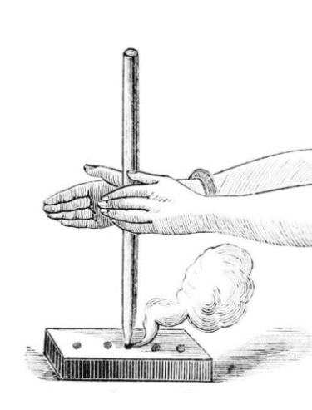
VRCAMP
Zenan Shang (SHNZEN001) – 3D Modeler
Erin Heath (HTHERI001) – Lead Developer
Mike Muponda (MPNMIK001) – Lead Designer

Slide 2
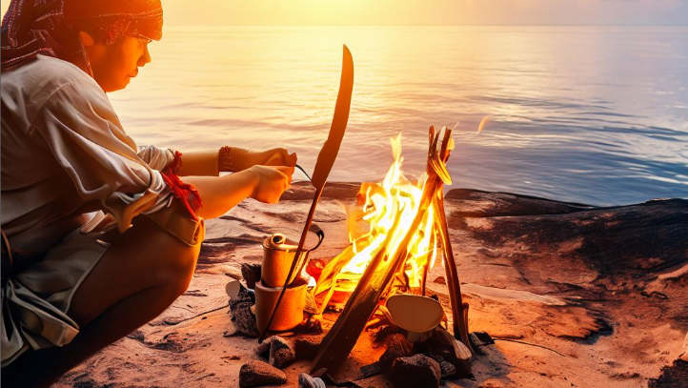
Basic Idea
Setup camp in the wild
Learn how to drill wood to make fire

Slide 3
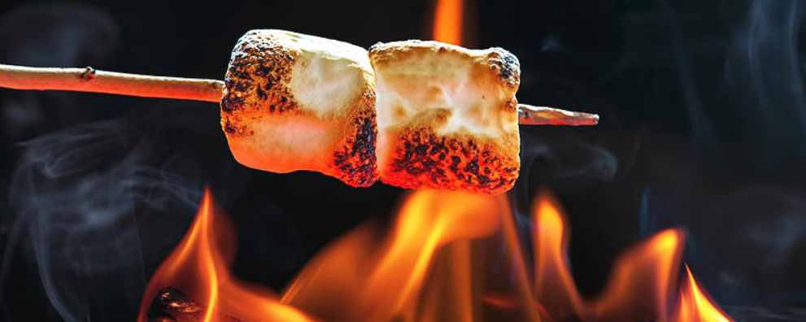
Core Mechanics
Drilling the wood plank using the wood stick to make fire
Place flammable foliage on the fire spark to create fire
Chilling by the fire and roasting marshmallows

Slide 4
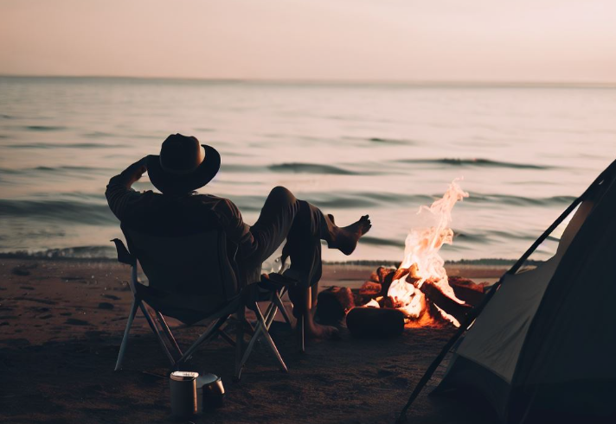
Selling points
Involving all 5 sensors
Interactive and immersive experience
Educational value
Relax and calm experience

